Slide 1
ATTRIBUTE TYPES
Data objects represents an entity
In a sale database: object-customer, store item
In a medical database: object-patients
Data objects are described using attributes
In a database: row- dataobjects, column- attributes
‹#›

Slide 2
ATTRIBUTE TYPES
Attributes represent characteristics or feature of a dataobject
Types:
Nominal
Binary
Ordinal
Numeric
‹#›

Slide 3
Nominal Attributes
Meaning: related to names
Value: are symbols or name of things
Each value represents some kind of category, code or state.
No meaningful order
Eg: haircolor and marital status are 2 attributes describing a person object
Haircolor value- black , brown , gray , white
‹#›

Slide 4
It is also possible to represent names with numbers
Integers are not meant to be used quantitatively
no sense to find mean or median
Mode- attributes most commonly occuring value
‹#›

Slide 5
Binary Attributes
Is a nominal attribute with only two categories or states 0 or 1
0 🡪 attribute is absent
1🡪 attribute is present
Attribute smoker for patient object, 1🡪patient smokes,0🡪 not smoker
Binary attribute is symmetric
If both of its states are equally valuable and carry the same weight
Eg: gender
‹#›

Slide 6
Asymmetric :
Outcomes of the states are not equally important
Eg: HIV positive( the rarest one is coded as more important) and negative
‹#›

Slide 7
Ordinal Attributes
Values with meaningful order or ranking among them
The magnitude between successive values is not known
Eg1: drink_size 🡪 Small, medium , large
Eg2: grade 🡪 A+, A, B+, B
Used in surveys for rating
Customer satisfaction – ordinal categories
0: very dissatisfied, 1: neutral, 2:very satisfied
‹#›

Slide 8
Central tendency of ordinal attribute-
Mode (frequently occurring)and
median
‹#›

Slide 9
Numeric Attributes
Quantitative
2 types:
Interval scaled
Ratio scaled
Interval Scaled:
measured on a scale of equal size units
Values have order
Have values- positive ,0, negative
Such attribute allow us to compare and quantify the difference between values
Mean, median and mode can be calculated
Eg: temperature attribute, calender attribute – no true zero point exists.

Slide 10
Ratio scaled attributes:
True zero point exist
One value can be a multiple of other value
Values are ordered
Calculate- mean, median & mode
eg: year_of_experience for employee object
Eg2: Number_of_words for object document

Slide 11
Discrete VS Continuous attributes
Discrete attributes:
Finite set of values and are discrete
Eg: attributes- haircolor, smoker, drink_size , age
Can have numeric values such as 0 or 1 for binary attributes
Continuous attributes
Countably infinite if the set of possible values is infinite
Values can be put in one to one correspondence with natural numbers
Eg: customer_ID

Slide 12
Similarity and dissimilarity measures

Slide 13
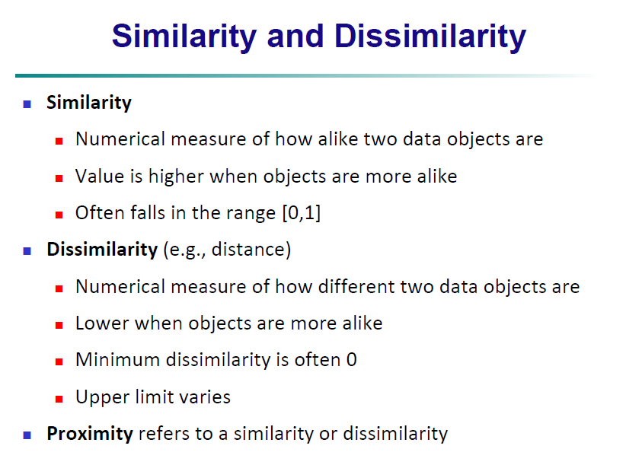

Slide 14
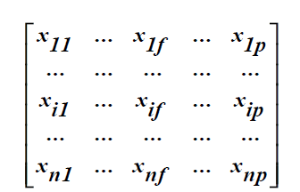
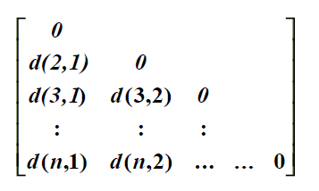
Data matrix:
n data points with p dimensions
Dissimilarity matrix:
n data points, but registers only the distance
A triangular matrix

Slide 15


1,Proximity Measure for Nominal Attributes
Can take 2 or more states, e.g., red, yellow, blue, green (generalization of a binary attribute)
Method 1: Simple matching
m: no. of matches, p: total no. of variables

Slide 16
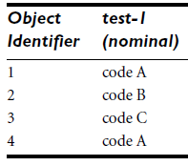
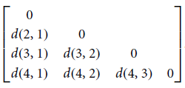
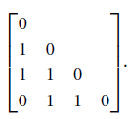

Slide 17
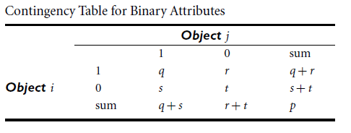
2,Proximity Measures for Binary Attributes
we have the 2*2 contingency table
where q is the number of attributes that equal 1 for both objects i and j,
r is the number of attributes that equal 1 for object i but equal 0 for object j,
s is the number of attributes that equal 0 for object i but equal 1 for object j, and
t is the number of attributes that equal 0 for both objects i and j.
The total number of attributes is p,

Slide 18



Asymmetric binary similarity:
The coefficient sim(i, j) is called the Jaccard coefficient

Slide 19
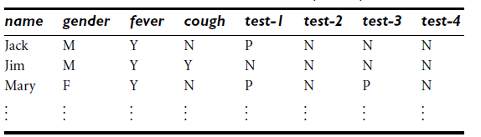
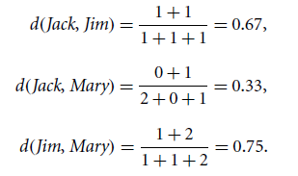
let the values Y (yes) and P (positive) be set to 1, and the value N (no or negative) be set to 0.
Jack and Mary are the most likely to have a similar disease.

Slide 20


3, Dissimilarity of Numeric Data
Euclidean distance:
Manhattan (or city block) distance:

Slide 21


Both the Euclidean and the Manhattan distance satisfy the following mathematical properties:

Slide 22


Minkowski distance is a generalization of the Euclidean and Manhattan distances.
The supremum distance is a generalization of the Minkowski distance for h🡪α.

Slide 23
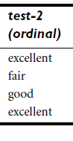
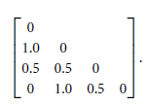
4, Proximity Measures for Ordinal Attributes
normalizes the ranking by mapping rank 1 to 0.0, rank 2 to 0.5, and rank 3 to 1.0.
Use the Euclidean distance
objects 1 and 2 , 2 and 4 are the most dissimilar

Slide 24
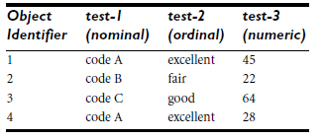
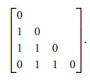

5,Dissimilarity for Attributes of Mixed Types

Slide 25

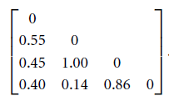

Normalize using:

Slide 26

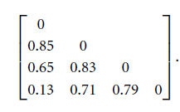

Slide 27
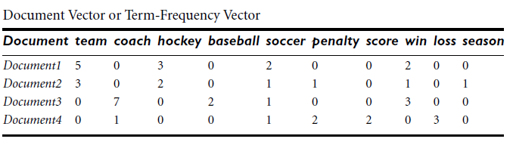

6,Cosine Similarity

Slide 28
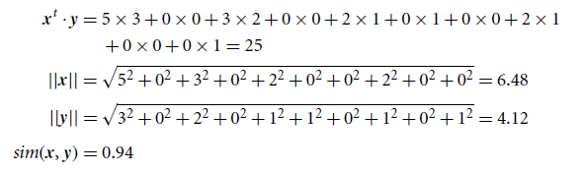
The closer the cosine value to 1, the smaller the
angle and the greater the match between vectors

Slide 29
Why Data Pre-processing?
Data in the real world is dirty
incomplete: lacking attribute values, lacking certain attributes of interest
e.g., occupation=“ ”
noisy: containing errors or outliers
e.g., Salary=“-10”
inconsistent: containing discrepancies in codes or names
e.g., Age=“42” Birthday=“03/07/1997”
e.g., Was rating “1,2,3”, now rating “A, B, C”
‹#›

Slide 30
DATA PREPROCESSING
To maintain data quality
Factors comprising data quality:
Accuracy
Should not have incorrect attribute values
Completeness
Attribute of interest should be complete ,
eg: customer informations
Consistency
Data must be consistent with other recorded data

Slide 31
Timeliness
Timely updations are important
Believability
Reflects how much the data are trusted by users
Interpretability
How easy the data are understood
‹#›

Slide 32
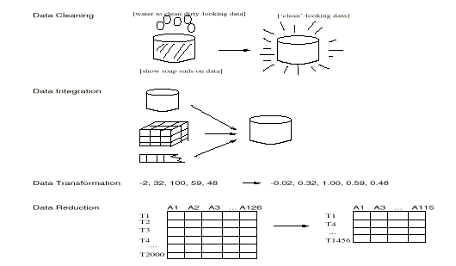
MAJOR TASKS IN DATA PREPROCESSING
‹#›

Slide 33
Major Tasks
Data Cleaning:
Clean the data by filling in missing values
Smoothing noisy data
Identifying or removing outliers
Removing inconsistencies
Data integration:
To include data from multiple sources
Causes inconsistencies and redundancies
‹#›

Slide 34
Data Reduction:
Huge data might slow down the mining process
Reduced representation of the data set that is much smaller in volume, yet produces the same analytical result.
Data Transformation:
where data are transformed or consolidated into forms appropriate for mining by performing summary operations
‹#›

Slide 35
DATA CLEANING
Data cleaning tasks:
Fill in missing values
Identify or remove outliers
Smoothing noisy data
Resolve inconsistencies
‹#›

Slide 36
Missing Data
Data is not always available
E.g., many tuples have no recorded value for several attributes, such as customer income in sales data
Missing data may be due to
equipment malfunction
inconsistent with other recorded data and thus deleted
data not entered due to misunderstanding
certain data may not be considered important at the time of entry
‹#›

Slide 37
How to Handle Missing Data?
Ignore the tuple:
usually done when class label is missing
Fill in the missing value manually: tedious + infeasible
Fill in it automatically with
a global constant : e.g., “unknown”, a new class
the attribute mean
the attribute mean for all samples belonging to the same class: smarter
the most probable value: inference-based such as Bayesian formula or decision tree
‹#›

Slide 38
Noisy Data
Noise: random error or variance in a measured variable
Incorrect attribute values may due to
faulty data collection instruments
data entry problems
data transmission problems
technology limitation
‹#›

Slide 39
How to Handle Noisy Data?
Binning
first sort data and partition into (equal-frequency) bins
then one can smooth by bin means, smooth by bin median, smooth by bin boundaries, etc.
Regression
smooth by fitting the data into regression functions
Outlier Analysis
detect and remove outliers
‹#›

Slide 40
Binning Methods for Data Smoothing
Sorted data for price (in dollars): 4, 8, 9, 15, 21, 21, 24, 25, 26, 28, 29, 34
* Partition into equal-frequency (equi-depth) bins:
- Bin 1: 4, 8, 9, 15
- Bin 2: 21, 21, 24, 25
- Bin 3: 26, 28, 29, 34
* Smoothing by bin means:
- Bin 1: 9, 9, 9, 9
- Bin 2: 23, 23, 23, 23
- Bin 3: 29, 29, 29, 29
* Smoothing by bin boundaries:
- Bin 1: 4, 4, 4, 15
- Bin 2: 21, 21, 25, 25
- Bin 3: 26, 26, 26, 34
‹#›

Slide 41
Cluster Analysis
‹#›

Slide 42
Data Integration
Data integration:
Merging of data from multiple data stores
Careful integration reduce redundancies and inconsistencies
Improve accuracy and speed of data mining
‹#›

Slide 43
Entity identification problem:
For the same real world entity, attribute values from different sources are different
e.g., Bill Clinton = William Clinton
E.g: Customer_id in one database and cust_number in other are same
Detecting and resolving data value conflicts by using metadata
a set of data that describes and gives information about other data.
‹#›

Slide 44
Handling Redundancy in Data Integration
Redundant data occur often when integration of
multiple databases
Inconsistencies in attribute naming can also cause
redundancies
The same attribute or object may have different names in different databases
Derivable data: One attribute may be a “derived” attribute in another table, e.g., annual revenue
‹#›

Slide 45
Redundant attributes may be able to be detected by correlation analysis
Given two attributes, how strongly one attribute implies the other, based on available data
For nominal data🡪 Χ² (chi-square) test
Numeric attributes🡪 correlation coefficient and covariance
‹#›

Slide 46

Χ² (chi-square) test
Χ² (chi-square) test
Oij🡪observed frequency
Eij🡪 expected frequency
The larger the Χ² value, the more likely the variables are related
The cells that contribute the most to the Χ² value are those whose actual count is very different from the expected count
‹#›

Slide 47
Chi-Square Calculation: An Example
we have two attributes, gender and preferred reading
Χ² (numbers in parenthesis are expected counts ) calculated based on the data distribution in the two categories)
male
female
Sum (row)
Like science fiction
250()
200()
450
Not like science fiction
50()
1000()
1050
Sum(col.)
300
1200
1500
‹#›

Slide 48
Chi-Square Calculation: An Example
we have two attributes, gender and preferred reading
Χ² (chi-square) calculation (numbers in parenthesis are expected counts calculated based on the data distribution in the two categories)
male
female
Sum (row)
Like science fiction
250(90)
200(360)
450
Not like science fiction
50(210)
1000(840)
1050
Sum(col.)
300
1200
1500
‹#›

Slide 49

With level of significance value 0.001 and the degree of freedom (r-1)(c-1), we can check the hypothesis
Since our computed value is above this 10.828
Since our computed value is above this, we can reject the hypothesis that gender and preferred reading are independent and conclude that the two attributes are (strongly) correlated for the given group of people.
‹#›

Slide 50
Data Transformation
In data transformation, the data are transformed or consolidated into forms appropriate for mining.
Data transformation can involve:
Smoothing
works to remove noise from the data.
Such techniques include binning, regression, and clustering.
Aggregation
summary or aggregation operations are applied to the data.
Eg: the daily sales data may be aggregated so as to compute monthly and annual total amounts.
‹#›

Slide 51
Generalization of the data
where low-level or “primitive” (raw) data are replaced by higher-level concepts through the use of concept hierarchies.
Eg: categorical attributes, like street, can be generalized to higher-level concepts, like city or country.
Eg: Similarly, values for numerical attributes, like age, may be mapped to higher-level concepts, like youth, middle-aged, and senior.
Normalization
the attribute data are scaled so as to fall within a small specified range, such as - 1.0 to 1.0, or 0.0 to 1.0 .
‹#›

Slide 52
Attribute construction (or feature construction)
where new attributes are constructed and added from the given set of attributes to help the mining process.
‹#›

Slide 53

Normalization
They fall within a small specified range
There are many methods for data normalization.
min-max normalization,
z-score normalization,
and normalization by decimal scaling.
min-max normalization:
‹#›

Slide 54
z-score normalization (or zero-mean normalization)
This method of normalization is useful when the actual minimum and maximum of attribute A are unknown
the values for an attribute A, are normalized based on the mean Â and standard deviation σ _{A} of A
‹#›

Slide 55
Normalization by decimal scaling:
normalizes by moving the decimal point of values of attribute A
The number of decimal points moved depends on the maximum absolute value of A
where j is the smallest integer such that Max(|v’|) < 1.
‹#›

Slide 56
attribute construction
new attributes are constructed from the given attributes and added
help improve the accuracy and understanding of structure in high-dimensional data.
For example, we may wish to add the attribute area based on the attributes height and width.
By combining attributes,
attribute construction can discover missing information about the relationships between data attributes that can be useful for knowledge discovery.
‹#›

Slide 57
Data Reduction
to obtain a reduced representation of the data set that is much smaller in volume
maintains the integrity of the original data.
mining on the reduced data set should be more efficient yet produce the same analytical results.
‹#›

Slide 58
Strategies for data reduction include the following:
Data cube aggregation
where aggregation operations are applied to the data in the construction of a data cube.
Attribute subset selection
where irrelevant, weakly relevant, or redundant attributes or dimensions may be detected and removed.
Dimensionality reduction
where encoding mechanisms are used to reduce the data set size.
‹#›

Slide 59
5. Numerosity reduction
where the data are replaced or estimated by alternative, smaller data representations such as parametric models (which need store only the model parameters instead of the actual data)
or nonparametric methods such as clustering, sampling, and the use of histograms.
6. Discretization and concept hierarchy generation
where raw data values for attributes are replaced by ranges or higher conceptual levels.
allows the mining of data at multiple levels of abstraction.
‹#›

Slide 60
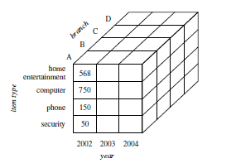
Data Cube Aggregation
Data cubes provide fast access to precomputed, summarized data.
thereby benefiting on-line analytical processing as well as data mining.
‹#›

Slide 61
Attribute Subset Selection
Data sets for analysis may contain hundreds of attributes, many of which may be irrelevant to the mining task
Added volume of irrelevant or redundant attributes can slow down the mining process.
Attribute subset selection reduces the data set size by removing irrelevant or redundant attributes
Mining on a reduced set of attributes has additional benefit.
It reduces the number of attributes appearing in the discovered patterns, helping to make the patterns easier to understand.
‹#›

Slide 62
“How can we find a ‘good’ subset of the original attributes?
For n attributes, there are 2^{n} possible subsets.
An exhaustive search for the optimal subset is expensive, as n and the number of data classes increase.
Therefore, heuristic methods that explore a reduced search space are commonly used
These methods are typically greedy in that, while searching through attribute space, they always make what looks to be the best choice at the time.
Such greedy methods are effective in practice and may come close to estimating an optimal solution
‹#›

Slide 63
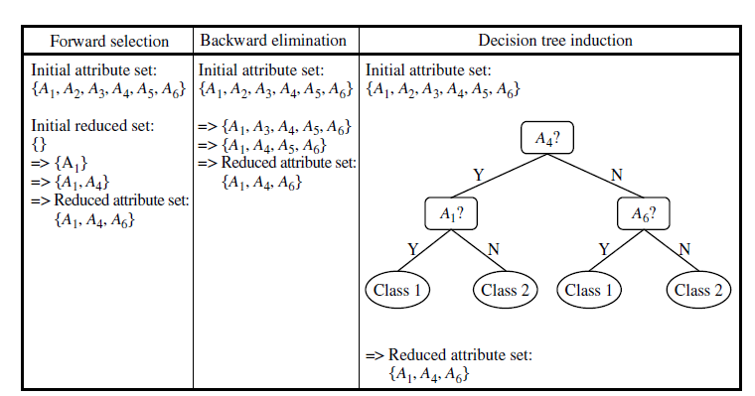
Basic heuristic methods of attribute subset selection include the following techniques:
‹#›

Slide 64
Stepwise forward selection:
The procedure starts with an empty set of attributes as the reduced set.
The best of the original attributes is determined and added to the reduced set. At each subsequent iteration or step, original attributes is added to the set. the best of the remaining
Stepwise backward elimination:
The procedure starts with the full set of attributes. At each step, it removes the worst attribute remaining in the set.
‹#›

Slide 65
Combination of forward selection and backward elimination:
The stepwise forward selection and backward elimination methods can be combined
at each step, the procedure selects the best attribute and removes the worst from among the remaining attributes
Decision tree induction:
Decision tree induction constructs a flowchart like structure
internal nodes denotes a test on an attribute,
each branch corresponds to an outcome of the test, and
each external (leaf) node denotes a class prediction
‹#›

Slide 66
When decision tree induction is used for attribute subset selection, a tree is constructed from the given data.
All attributes that do not appear in the tree are assumed to be irrelevant.
The set of attributes appearing in the tree form the reduced subset of attributes.
The stopping criteria for the methods may vary.
The procedure may employ a threshold on the measure used to determine when to stop the attribute selection process.
‹#›

Slide 67
Dimensionality Reduction
data encoding or transformations are applied so as to obtain a reduced or “compressed” representation of the original data.
If the original data can be reconstructed from the compressed data without any loss of information, the data reduction is called lossless.
If, instead, we can reconstruct only an approximation of the original data 🡪 lossy.
two popular and effective methods of lossy dimensionality reduction:
wavelet transforms and
Principal components analysis.
‹#›

Slide 68
Wavelet Transforms
A compressed approximation of the data can be retained by storing only a small fraction of the strongest of the wavelet coefficients.
For example, all wavelet coefficients larger than some user-specified threshold can be retained.
All other coefficients are set to 0.
The resulting data representation is therefore very sparse, data sparsity are computationally very fast if performed in wavelet space.
The technique also works to remove noise without smoothing out the main features of the data, making it effective for data cleaning as well.
‹#›

Slide 69
Given a set of coefficients, an approximation of the original data can be constructed by applying the inverse of the DWT used.
The DWT is closely related to the discrete Fourier transform(DFT)
the DWT achieves better lossy compression.
the DWT requires less space than the DFT.
‹#›

Slide 70
The general procedure for applying a discrete wavelet transform uses a hierarchical pyramid algorithm
that halves the data at each iteration, resulting in fast computational speed.
1. The length L, of the input data vector must be an integer power of 2.
2. Each transform involves applying two functions.
The first applies some data smoothing, such as a sum or weighted average.
The second performs a weighted difference ,which acts to bring out the detailed features of the data.
‹#›

Slide 71
3. The two functions are applied to pairs of data points in X
This represents a smoothed or low-frequency version of the input data and the high frequency content of it, respectively.
4. The two functions are recursively applied to the sets of data obtained in the previous loop, until the resulting data sets obtained are of length 2.
5. Selected values from the data sets obtained in the above iterations are designated the wavelet coefficients of the transformed data.
‹#›

Slide 72
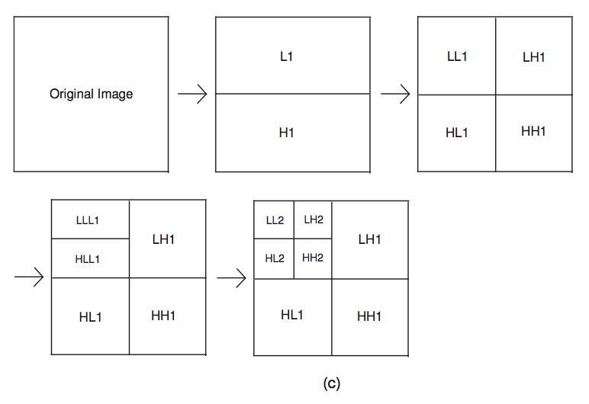
‹#›

Slide 73
Wavelet transforms can be applied to multidimensional data, such as a data cube.
This is done by first applying the transform to the first dimension, then to the second, and so on.
The computational complexity involved is linear with respect to the number of cells in the cube.
‹#›

Slide 74
Principal Components Analysis
Suppose that the data to be reduced consist of tuples or data vectors described by n attributes or dimensions.
Principal components analysis, searches for k n-dimensional orthogonal vectors that can best be used to represent the data, where k<=n.
The original data are thus projected onto a much smaller space, resulting in dimensionality reduction.
Unlike attribute subset selection, which reduces the attribute set size by retaining a subset of the initial set of attributes, PCA “combines” the essence of attributes by creating an alternative, smaller set of variables.
The initial data can then be projected onto this smaller set.
‹#›

Slide 75
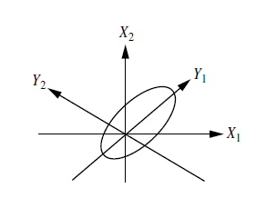
‹#›

Slide 76
Numerosity Reduction
These techniques may be parametric or nonparametric.
For parametric methods,
a model is used to estimate the data,
typically only the data parameters need to be stored, instead of the actual data.
Eg: log linear method
Nonparametric methods for storing reduced representations of the data include histograms, clustering, and sampling.
‹#›

Slide 77
Regression and Log-Linear Models
In linear regression,
the data are modeled to fit a straight line.
For example, a random variable, y (called a response variable), can be modeled as a linear function of another random variable, x (called a predictor variable),
y = wx+b,
The coefficients, w and b (called regression coefficients),
specify the slope of the line and the Y-intercept, respectively
‹#›

Slide 78
Log linear
Given a set of tuples in n dimensions we can consider each tuple as a point in an n-dimensional space.
Log-linear models are therefore also useful for dimensionality reduction and data smoothing
Regression and log-linear models can both be used on sparse data
While both methods can handle skewed data, regression does exceptionally well.
Regression can be computationally intensive when applied to high dimensional data, whereas log-linear models show good scalability for up to 10 or so dimensions
‹#›

Slide 79
Histograms
Histograms use binning to approximate data distributions
A histogram for an attribute, A, partitions the data distribution of A into disjoint subsets, or buckets.
If each bucket represents only a single attribute-value/frequency pair, the buckets are called singleton buckets.
‹#›

Slide 80
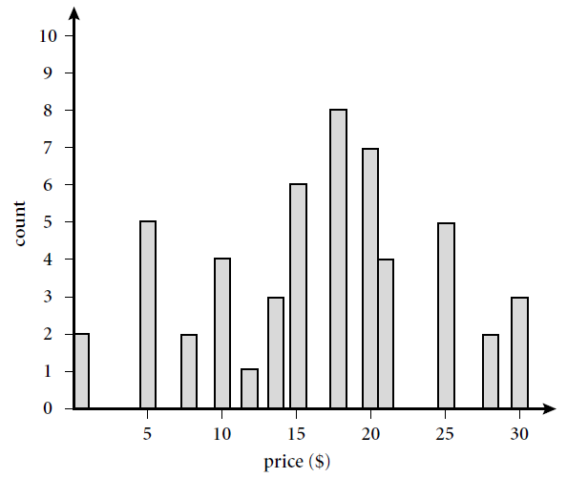
Eg: 1, 1, 5, 5, 5, 5, 5, 8, 8, 10, 10, 10, 10, 12, 14, 14, 14, 15, 15, 15, 15, 15, 15, 18, 18, 18, 18, 18, 18, 18, 18, 20, 20, 20, 20, 20, 20, 20, 21, 21, 21, 21, 25, 25, 25, 25, 25, 28, 28, 30, 30, 30.
‹#›

Slide 81
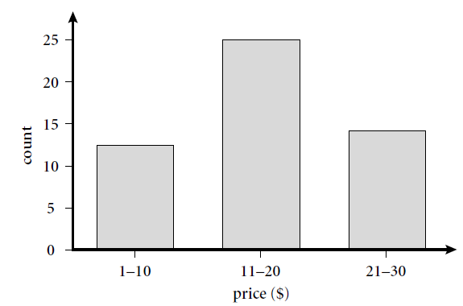
How are the buckets determined and the attribute values partitioned?
Rules:
Equal-width: In an equal-width histogram, the width of each bucket range is uniform
(such as the width of $10 for the buckets).
‹#›

Slide 82
Equal-frequency (or equidepth):
In an equal-frequency histogram, the buckets are created so that, roughly, the frequency of each bucket is constant
V-Optimal:
If we consider all of the possible histograms for a given number of buckets, the V-Optimal histogram is the one with the least variance.
‹#›

Slide 83
MaxDiff:
In a MaxDiff histogram, we consider the difference between each pair of adjacent values.
A bucket boundary is established between each pair for pairs having the β-1 largest differences, where β is the user-specified number of buckets.
V-Optimal and MaxDiff histograms tend to be the most accurate and practical.
‹#›

Slide 84
Clustering
partition the objects into groups or clusters
objects within a cluster are “similar” to one another and “dissimilar” to objects in other clusters.
“closeness” of the object - distance function.
The “quality” of a cluster may be represented by its diameter, the maximum distance between any two objects in the cluster.
Centroid distance is an alternative measure of cluster quality and is defined as the average distance of each cluster object from the cluster centroid
‹#›

Slide 85
Sampling
large data set can be represented by a much smaller random sample (or subset) of the data.
Suppose that a large data set, D, contains N tuples.
most common ways for sampling D for data reduction:
Simple random sample without replacement (SRSWOR) of size s:
This is created by drawing s of the N tuples fromD (s < N), where the probability of drawing any tuple in D is 1/N, that is, all tuples are equally likely to be sampled.
‹#›

Slide 86
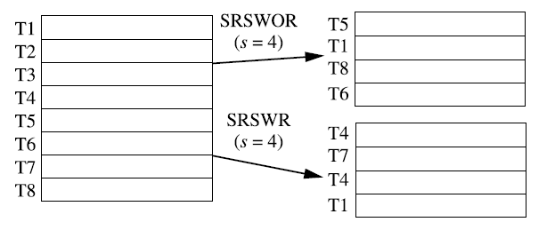
Simple random sample with replacement (SRSWR) of size s:
a tuple is drawn from D, it is recorded and then replaced.
That is, after a tuple is drawn, it is placed back in D so that it may be drawn again.
‹#›

Slide 87
Cluster sample:
If the tuples in D are grouped into M mutually disjoint “clusters,” then an SRS of s clusters can be obtained, where s < M.
For example, tuples in a database are usually retrieved a page at a time, so that each page can be considered a cluster.
A reduced data representation can be obtained by applying, say, SRSWOR to the pages, resulting in a cluster sample of the tuples.
‹#›

Slide 88
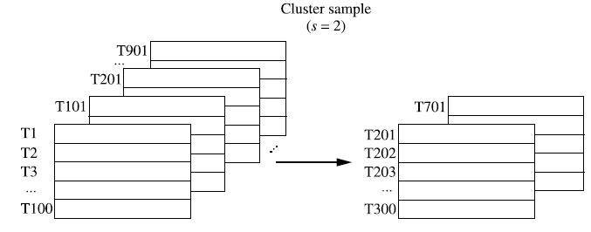
‹#›

Slide 89
Stratified sample:
If D is divided into mutually disjoint parts called strata, a stratified sample of D is generated by obtaining an SRS at each stratum.
This helps ensure a representative sample
Eg: a stratum is created for each customer age group. The age group having the smallest number of customers will be sure to be represented.
‹#›

Slide 90
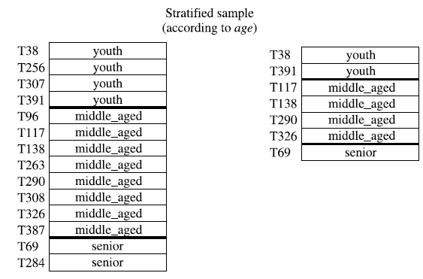
‹#›

Slide 91
Data Discretization and Concept Hierarchy Generation
Data discretization techniques can be used to reduce the number of values
a given continuous attribute by dividing the range of the attribute into intervals.
Interval labels can then be used to replace actual data values.
Replacing numerous values of a continuous attribute by a small number of interval labels thereby reduces and simplifies the original data.
‹#›

Slide 92
Discretization techniques can be categorized based on how the discretization is performed
whether it uses class information
or which direction it proceeds (i.e., top-down vs. bottom-up).
If the discretization process uses class information, then we say it is supervised discretization. Otherwise, it is unsupervised.
If the process starts by first finding one or a few points (called split points or cut points) to split the entire attribute range, and then repeats this recursively
it is called top-down discretization or splitting.
‹#›

Slide 93
bottom-up discretization or merging
starts by considering all of the continuous values as potential split-points,
removes some by merging neighborhood values to form intervals,
and then recursively applies this process to the resulting intervals.
Discretization can be performed recursively on an attribute to provide a hierarchical known as a concept hierarchy.
Concept hierarchies are useful for mining at multiple levels of abstraction.
‹#›

Slide 94
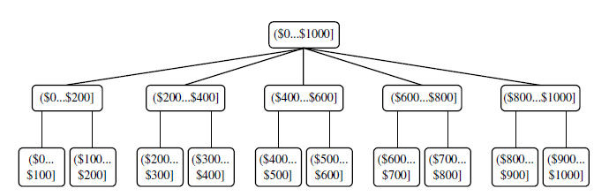
Concept hierarchies can be used to reduce the data by collecting and replacing low-level concepts with higher-level concepts
the attribute age with youth, middle-aged, or senior.
‹#›

Slide 95
Mining Association Rules
frequent itemset
a set of items, such as milk and bread, that appear frequently together in a transaction
Frequent itemset mining
Business Application
discovery of interesting correlation relationships among huge amounts of business transaction records can help in many business decision-making processes
catalog design,customer shopping behavior analysis.
‹#›

Slide 96
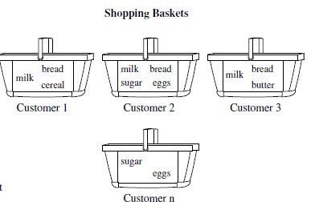
Market basket analysis:
This process analyzes customer buying habits by finding associations between the different items that customers place in their “shopping baskets
‹#›

Slide 97
These frequent patterns can be represented in the form of association rules.
For example, the information that customers who purchase computers also tend to buy antivirus software at the same time is represented in Association Rule :
Rule support and confidence are two measures of rule interestingness.
‹#›

Slide 98
Typically, association rules are considered interesting if they satisfy both a minimum support threshold and a minimum confidence threshold.
Such thresholds can be set by users or domain experts.
The rule A🡪B holds in the transaction set D with support s, where s is the percentage of transactions in D that contain. P(AUB)
The rule A 🡪 B has confidence c in the transaction set D, where c is the percentage of transactions in D containing A that also contain B.
P(B|A)
‹#›

Slide 99

Rules that satisfy both a minimum support threshold (min_sup) and a minimum Confidence threshold (min_conf) are called strong.
A set of items is referred to as an itemset.
k items 🡪 k-itemset.
‹#›

Slide 100
The set {computer, antivirus software} is a 2-itemset.
The occurrence frequency of an itemset
is the number of transactions that contain the itemset.
This is also known, frequency, support count, or count of the itemset.
‹#›

Slide 101
mining association rules can be reduced to that of mining frequent itemsets.
In general, association rule mining can be viewed as a two-step process:
Find all frequent itemsets:
By definition, each of these itemsets will occur at least as frequently as a predetermined minimum support count, min sup.
Generate strong association rules from the frequent itemsets:
By definition, these rules must satisfy minimum support and minimum confidence.
‹#›

Slide 102
Efficient and Scalable Frequent Itemset Mining Methods
The Apriori Algorithm:
Algorithm for mining frequent itemsets for Boolean association rules.
The name of the algorithm is based on the fact that the algorithm uses prior knowledge of frequent itemset properties
‹#›

Slide 103
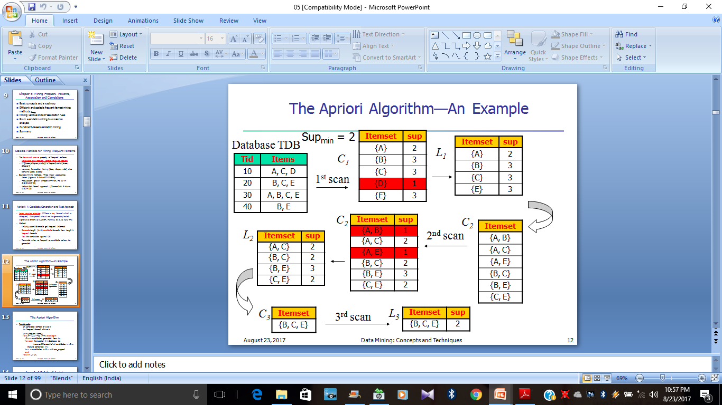
‹#›

Slide 104
Apriori employs an iterative approach known as a level-wise search, where k-itemsets are used to explore (k+1)-itemsets
First, the setof frequent 1-itemsets is found by scanning the database to accumulate the count for each item,
and collecting those items that satisfy minimum support.
The resulting set is denoted L1
Next, L1 is used to find L2, the set of frequent 2-itemsets, which is used to find L3, and so on, until no more frequent k-itemsets can be found.
The finding of each Lk requires one full scan of the database.
‹#›

Slide 105
To improve the efficiency of the level-wise generation of frequent itemsets, an important property called the Apriori property is used
Apriori property: All nonempty subsets of a frequent itemset must also be frequent.
if an itemset I does not satisfy the minimum support threshold, min sup, then I is not frequent
‹#›

Slide 106
A two main steps:
join and prune actions
The join step:
To find L_{k}, a set of candidate k-temsets is generated by joining L_{k-1} with itself. This set of candidates is denoted C_{k}.
‹#›

Slide 107
By convention, Apriori assumes that items within a transaction or itemset are sorted in lexicographic order.
For the (k-1)-itemset, l_{i}, this means that the items are sorted such that l_{i}[1] < l_{i}[2] <….< l_{i}[k-1].
The join, L_{k-1} * L_{k-1}, is performed, where members of Lk-1 are joinable if their first (k-2) items are in common
‹#›

Slide 108
members l₁ and l₂ of L_{k-1} are joined if (l₁[1] = l₂[1]) ^ (l₁[2] = l₂[2]) ^….^(l₁[k-2] = l₂[k-2]) ^(l₁[k-1] < l₂[k-1]).
The condition l1[k-1] < l2[k-1] simply ensures that no duplicates are generated.
The resulting itemset formed by joining l1 and l2 is l1[1], l1[2], ----, l1[k-2], l1[k-1], l2[k-1].
‹#›

Slide 109
The prune step:
C_{k} is a superset of L_{k}, that is, its members may or may not be frequent, but all of the frequent k-itemsets are included in C_{k}.
A scan of the database to determine the count of each candidate in C_{k} would result in the determination of L_{k}
‹#›

Slide 110
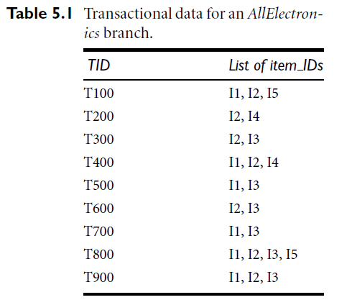
Min_sup =2
‹#›

Slide 111
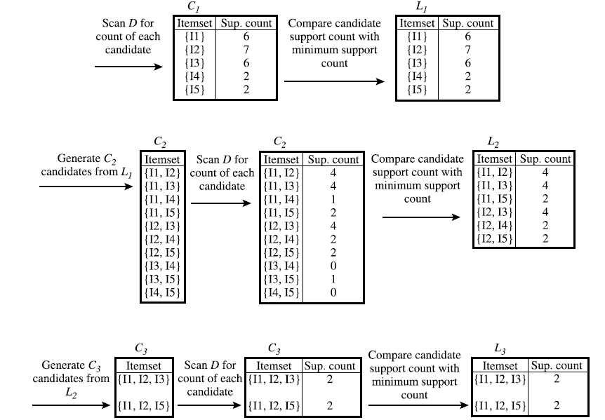
All nonempty subsets of a frequent itemset must also be frequent
‹#›

Slide 112
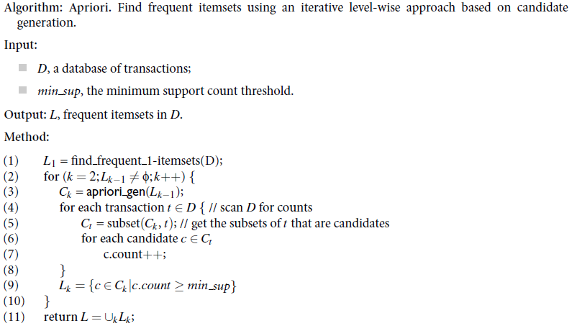
‹#›

Slide 113
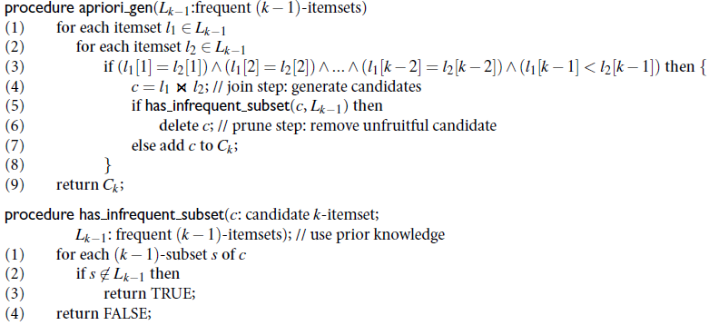
‹#›

Slide 114
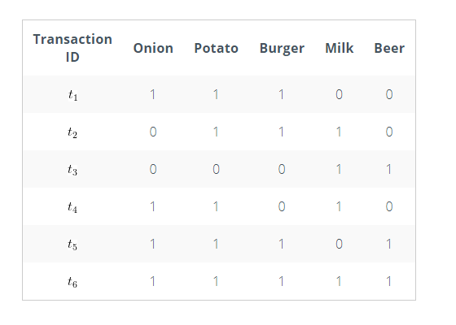
Min_sup =3
‹#›

Slide 115
Therefore, the set of 3 items that was purchased most frequently is OPB.
‹#›

Slide 116
Generating Association Rules from Frequent Itemsets
Suppose the data contain the frequent itemset
l = {I1, I2, I5}. What are the association rules that can be generated from l?
‹#›

Slide 117
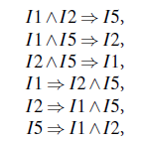
‹#›

Slide 118
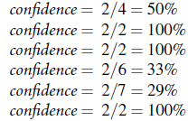
Min_conf=70%
‹#›

Slide 119
Mining Frequent Itemsets without Candidate Generation
Apriori suffers from two costs issues:
It may need to generate a huge number of candidate sets
It may need to repeatedly scan the database and check a large set of candidates by pattern matching.
frequent itemsets without candidate generation
‹#›

Slide 120
frequent-pattern growth, (FP-growth)
The first scan of the database is the same as Apriori, which derives the set of frequent items (1-itemsets) and their support counts (frequencies).
Let the minimum support count be 2.
The set of frequent items is sorted in the order of descending support count.
First, create the root of the tree, labeled with “null.”
a branch is created for each transaction.
‹#›

Slide 121
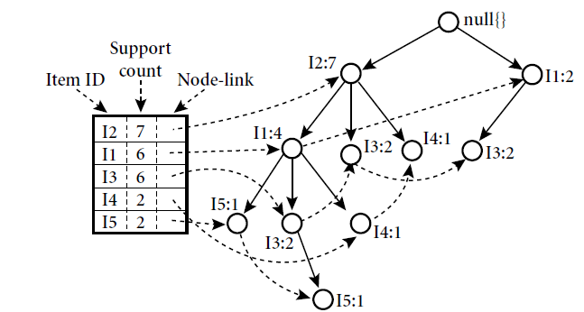
‹#›

Slide 122
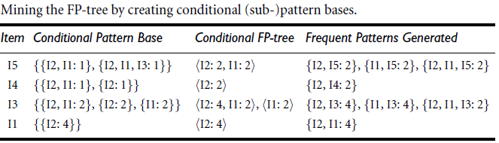
‹#›

Slide 123
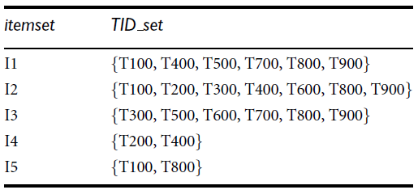
Mining Frequent Itemsets Using Vertical Data Format
Horizontal data format
Apriori and FP-growth methods
Vertical Data Format
‹#›

Slide 124
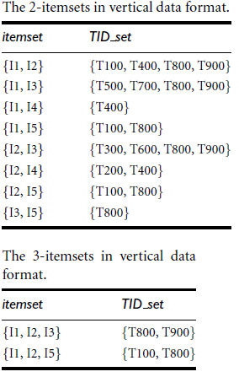
‹#›

Slide 125
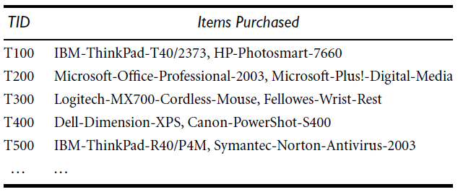
Mining Various Kinds of Association Rules
Mining Multilevel Association Rules
A concept hierarchy defines a sequence of mappings from a set of low-level concepts to higherlevel
‹#›

Slide 126
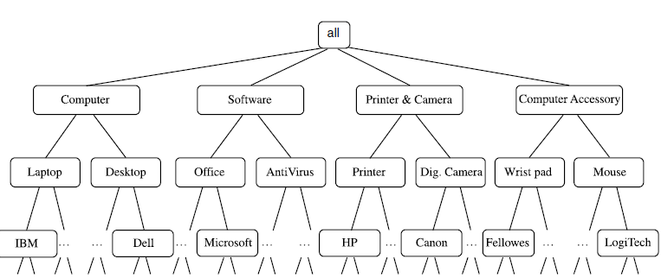
‹#›

Slide 127
Association rules generated from mining data at multiple levels of abstraction are called multiple-level or multilevel association rules
Multilevel association rules can be mined efficiently using concept hierarchies under a support-confidence framework
For each level, any algorithm for discovering frequent itemsets may be used, such as Apriori or its variations
‹#›

Slide 128
Using uniform minimum support for all levels:
The same minimum support threshold is used when mining at each level of abstraction.
For example, a minimum support threshold of 5% is used throughout
Both “computer” and “laptop computer” are found to be frequent, while “desktop computer” is not.
‹#›

Slide 129
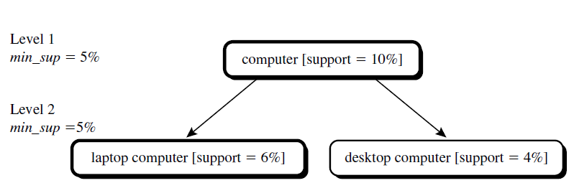
The method is also simple in that users are required to specify only one minimum support threshold
If the minimum support threshold is set too high, it could miss some meaningful associations occurring at low abstraction levels.
If the threshold is set too low, it may generate many uninteresting associations occurring at high abstraction levels
‹#›

Slide 130
Using reduced minimum support at lower levels
Each level of abstraction has its own minimum support threshold.
The deeper the level of abstraction, the smaller the corresponding threshold is.
For example,, the minimum support thresholds for levels 1 and 2 are 5% and 3%
In this way, “computer,” “laptop computer,” and “desktop computer” are all considered frequent.
‹#›

Slide 131
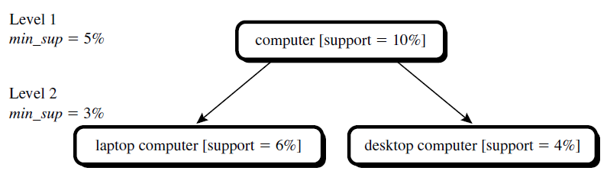
Using item or group-based minimum support
more desirable to set up user-specific, item, or group based minimal support thresholds when mining multilevel rules.
For example, a user could set up the minimum support thresholds based on product price, or on items of interest
‹#›

Slide 132
END OF MODULE 1
‹#›

